Slide 1
Session 1
By : Ahmed Elnemr

Slide 2
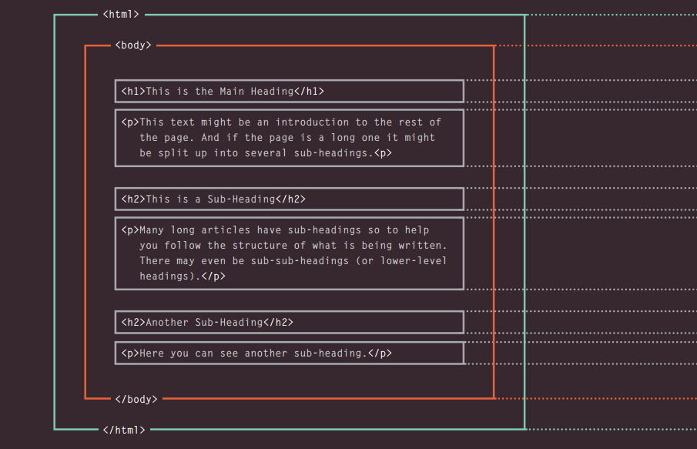
HTML Describes the Structure of Pages

Slide 3
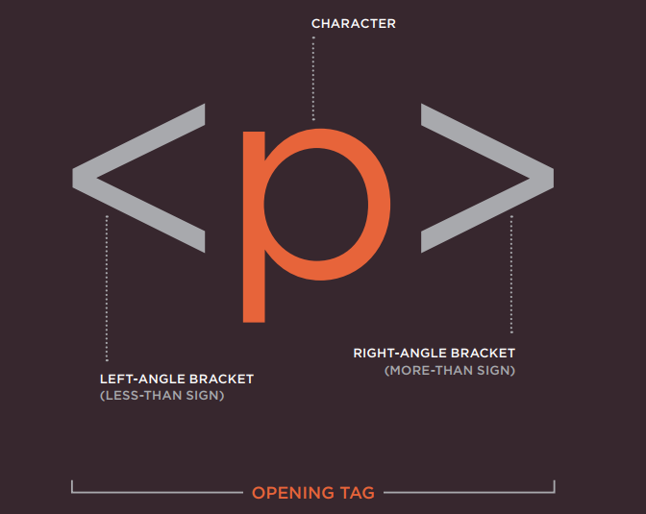
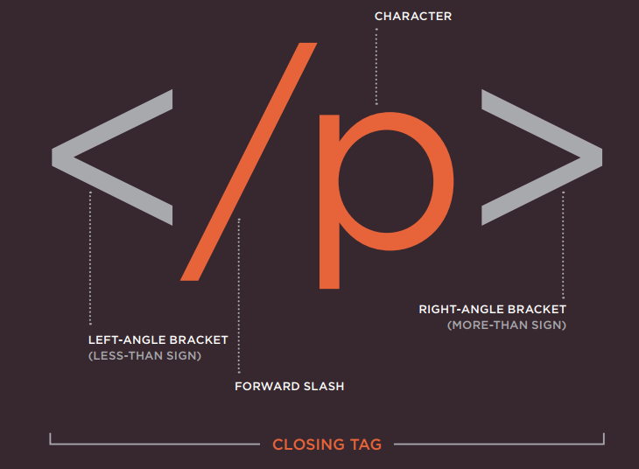
A Closer Look at Tags

Slide 4
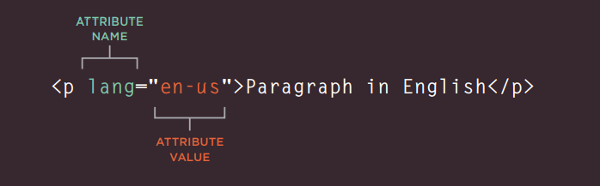
Attributes Tell Us More About Elements
Attributes provide additional information
about the contents of an element. They appear
on the opening tag of the element and are
made up of two parts: a name and a value,
separated by an equals sign.

Slide 5
Headings
<h1>
<h2>
<h3>
<h4>
<h5>
<h6>
HTML has six "levels" of
headings:
<h1> is used for main headings
<h2> is used for subheadings
If there are further sections
under the subheadings then the
<h3> element is used, and so
on...

Slide 6
Paragraph
<b>
<p>
By enclosing words in the tags and we can make characters appear bold.
To create a paragraph, surround
the words that make up the
paragraph with an opening <p>
tag and closing </p> tag
<i>
By enclosing words in the tags and we can make characters appear italic.

Slide 7
Format
<br />
<hr />
As you have already seen, the
browser will automatically show
each new paragraph or heading
on a new line. But if you wanted
to add a line break inside the
middle of a paragraph you can
use the line break tag <br />.
To create a break between
themes — such as a change of
topic in a book or a new scene
in a play — you can add a
horizontal rule between sections
using the <hr /> tag.

Slide 8
Lists
Ordered lists
Unordered lists
are lists where each item in the list is
numbered. For example, the list might be a set of steps for
a recipe that must be performed in order, or a legal contract
where each point needs to be identified by a section
number.
are lists that begin with a bullet point
(rather than characters that indicate order).

Slide 9
Lists
<ol>
<ul>
The ordered list is created with
the <ol> element.
The unordered list is created
with the <ul> element.
<li>
Each item in the list is placed
between an opening <li> tag
and a closing </li> tag. (The li
stands for list item.)

Slide 10
Layout
<div>
The <div> tag defines a division or a section in an HTML document.
The <div> element is often used as a container for other HTML elements to style them with CSS or to perform certain tasks with JavaScript.
</div>

Slide 11
<span>
The <span> tag is used to group inline-elements in a document.
The <span> tag provides a way to add a hook to a part of a text or a part of a document.
</span>

